Slide 1
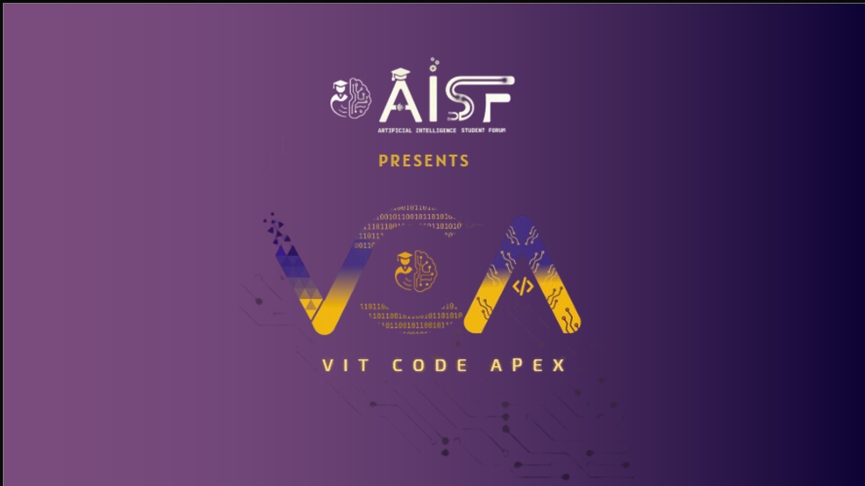

Slide 2

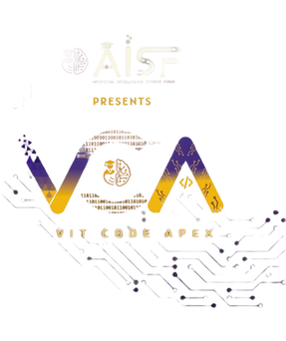
TEAM : TRIPLE SYNTAX
Track 3 - General:
Problem Statement 14: Create a "living itinerary" system that dynamically adjusts a traveler's plans in real-time based on live events and user feedback.

Slide 3
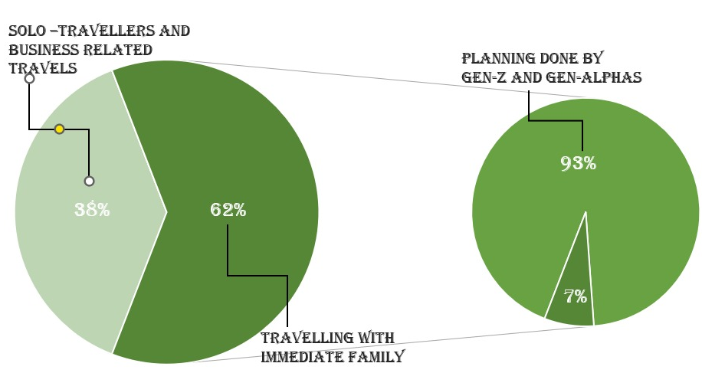
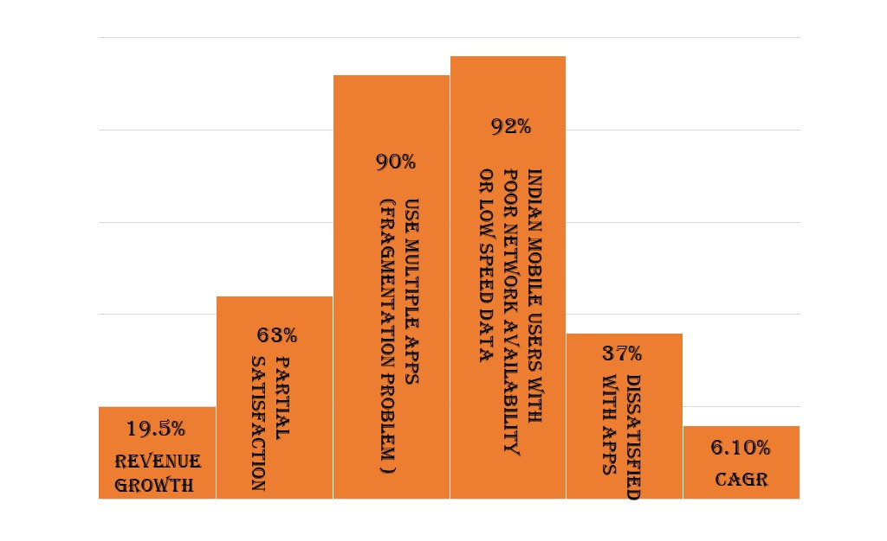
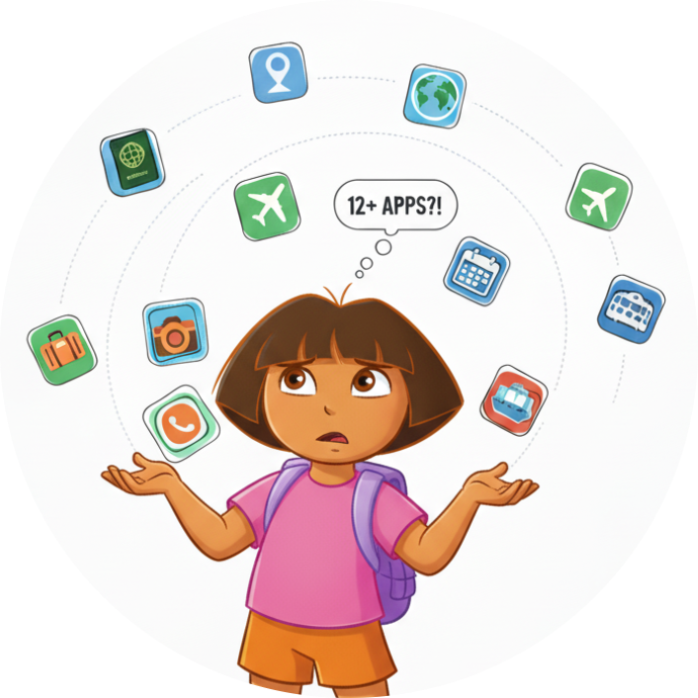
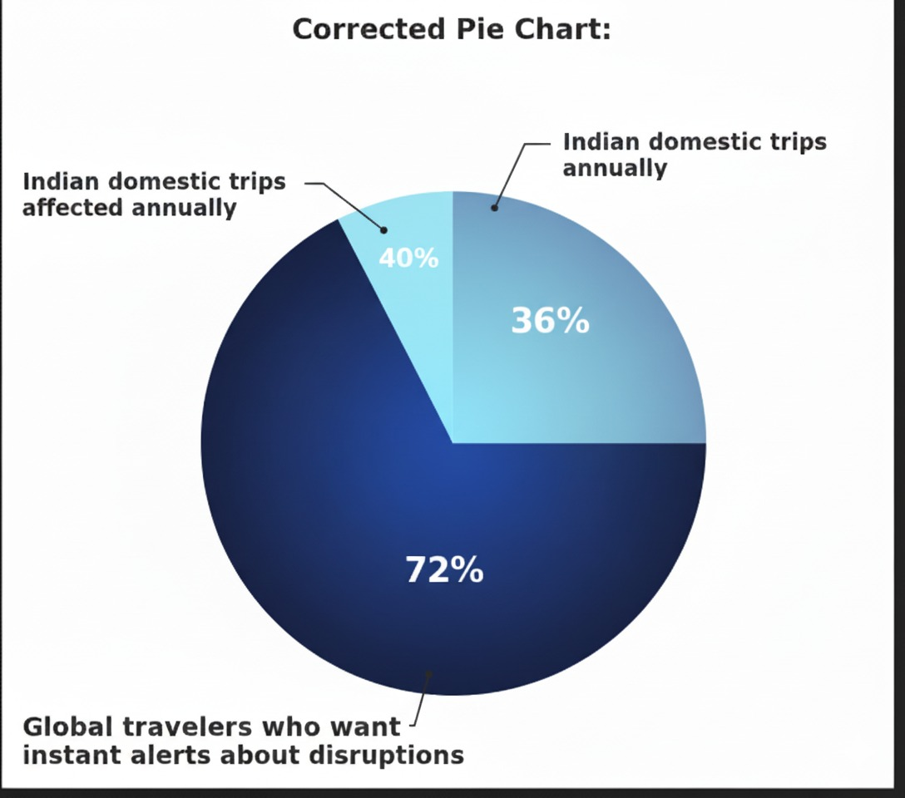
PROBLEM: THE TRAVELLING CHAOS
Challenges and Trends in the Indian Mobile Travel App Market
Traveler Demographics and Planning Behavior : the breakdown of solo versus family travelers and the role of younger generations in travel planning.
Indian Domestic Travel Preferences : the strong global demand for instant disruption alerts among travelers

Slide 4

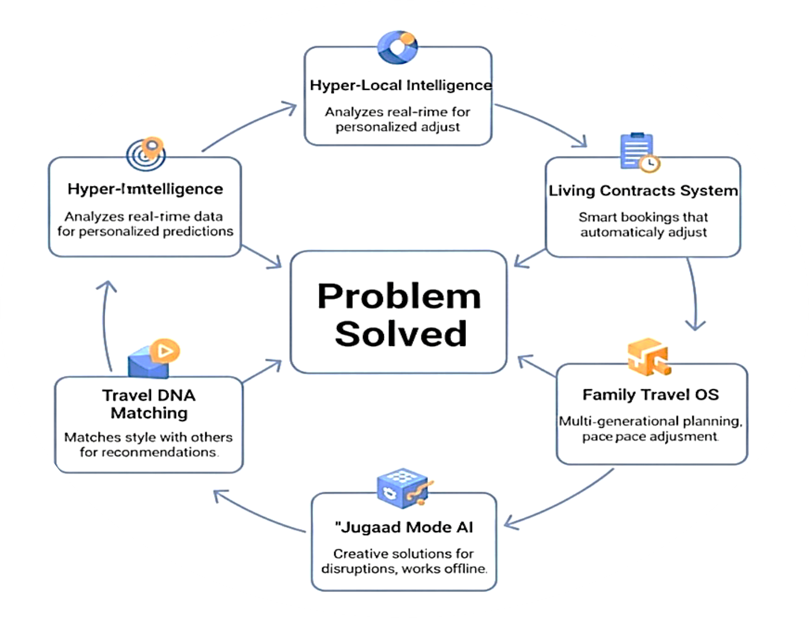
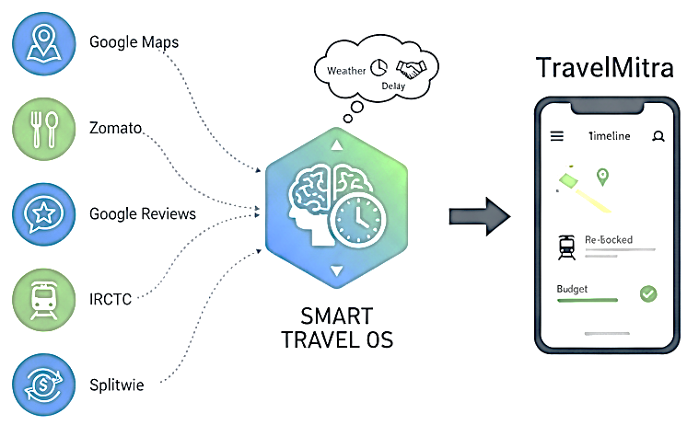
Our Solution : TRAVELMITRA
A Travel Operating System powered by AI, blockchain, and real traveler insights. Building a smarter, adaptive travel experience for everyone.

Slide 5
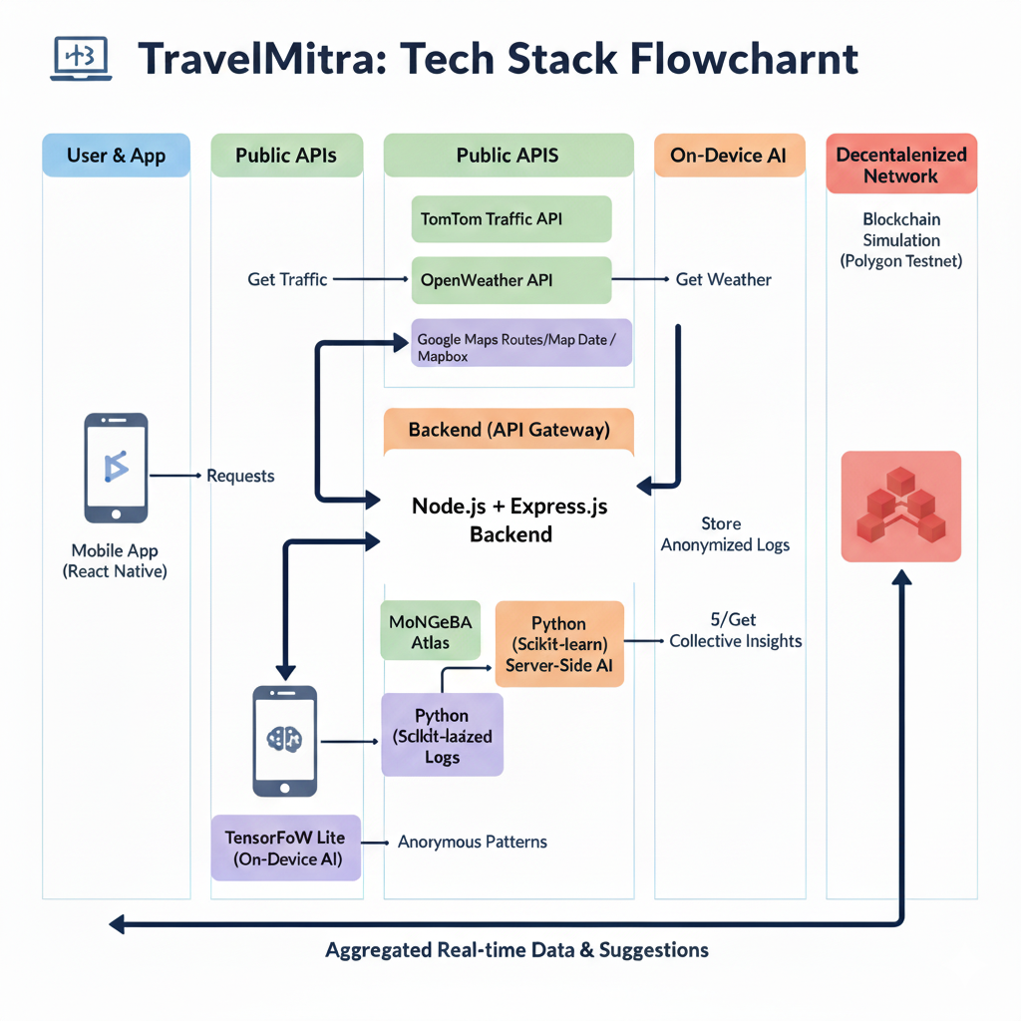
APPROACH
TECHNICAL

Slide 6
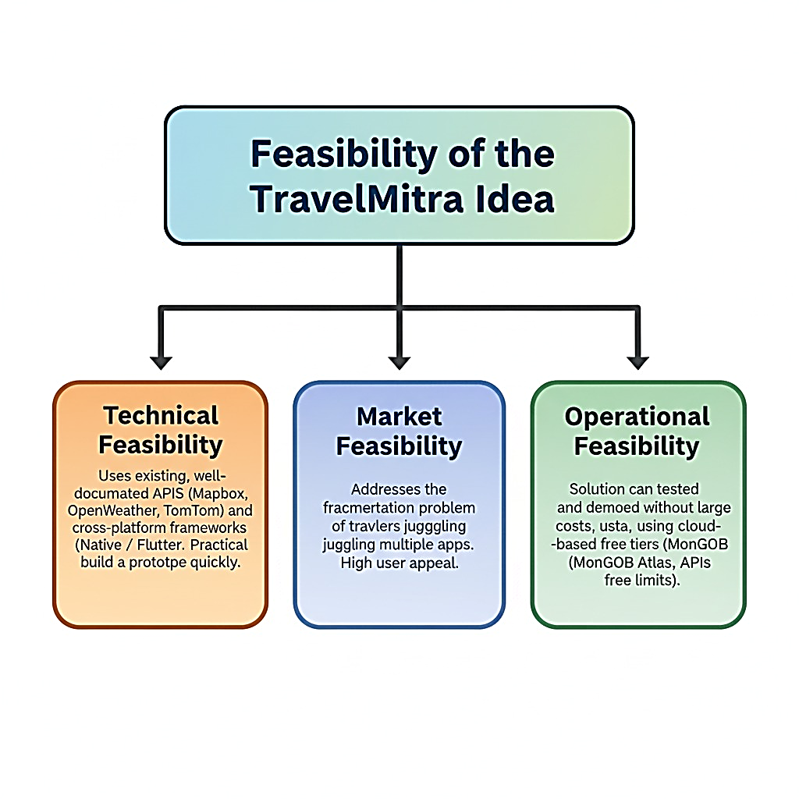
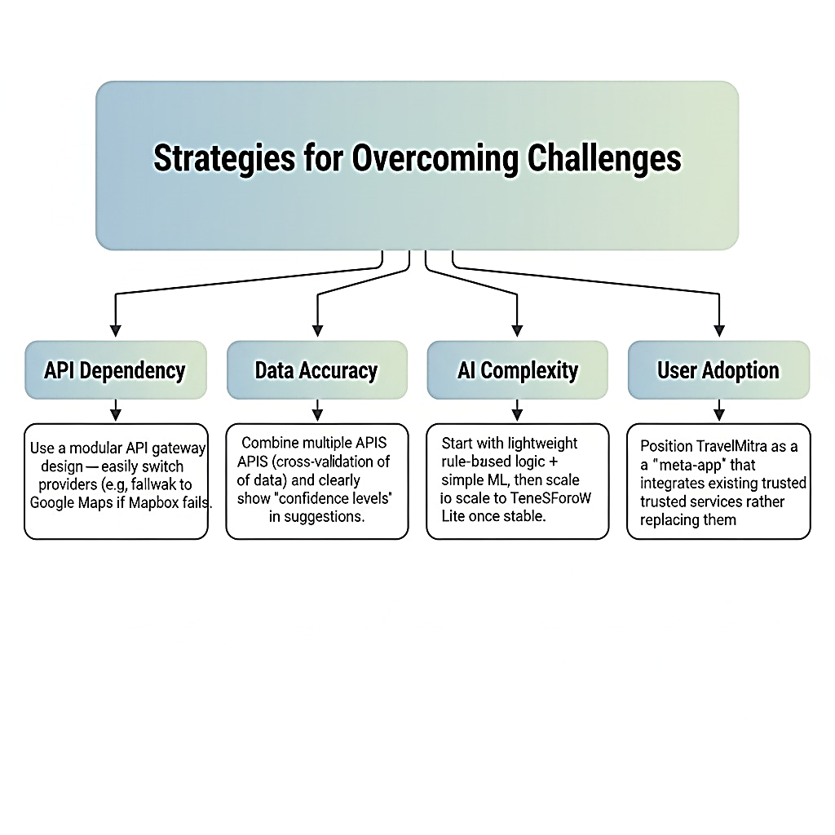
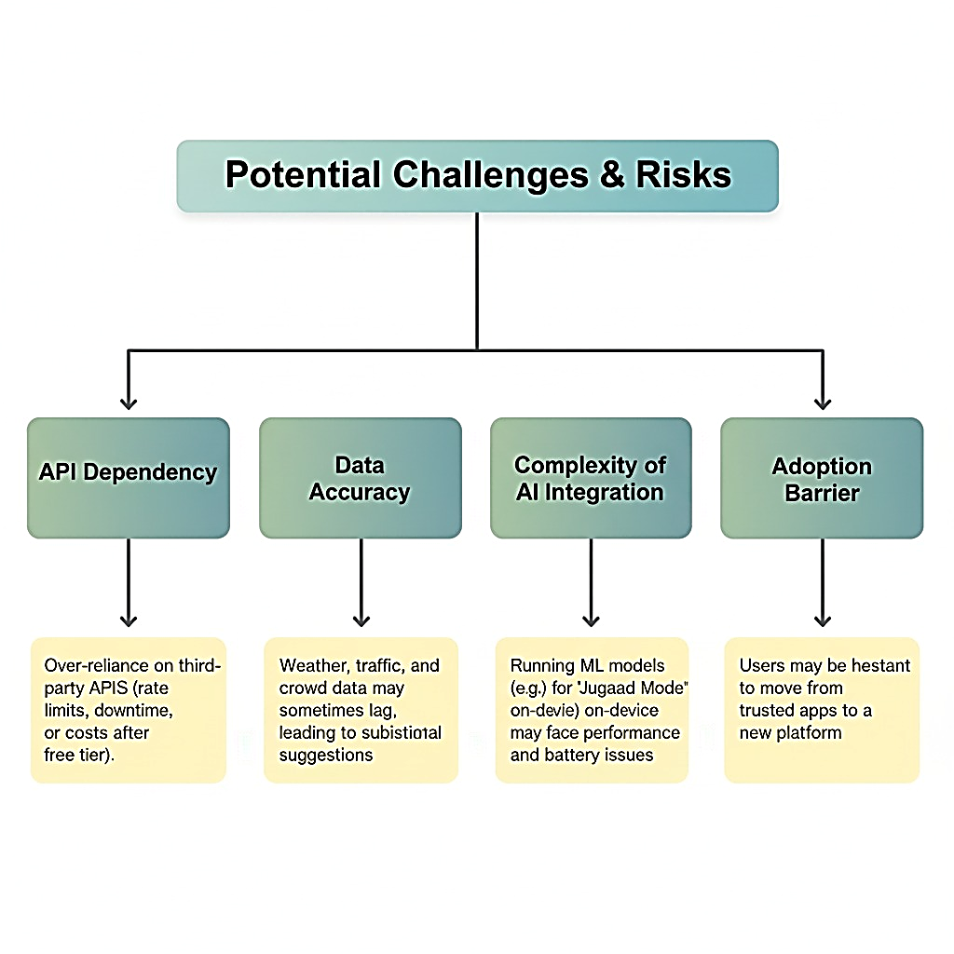
Feasibility and Viability

Slide 7
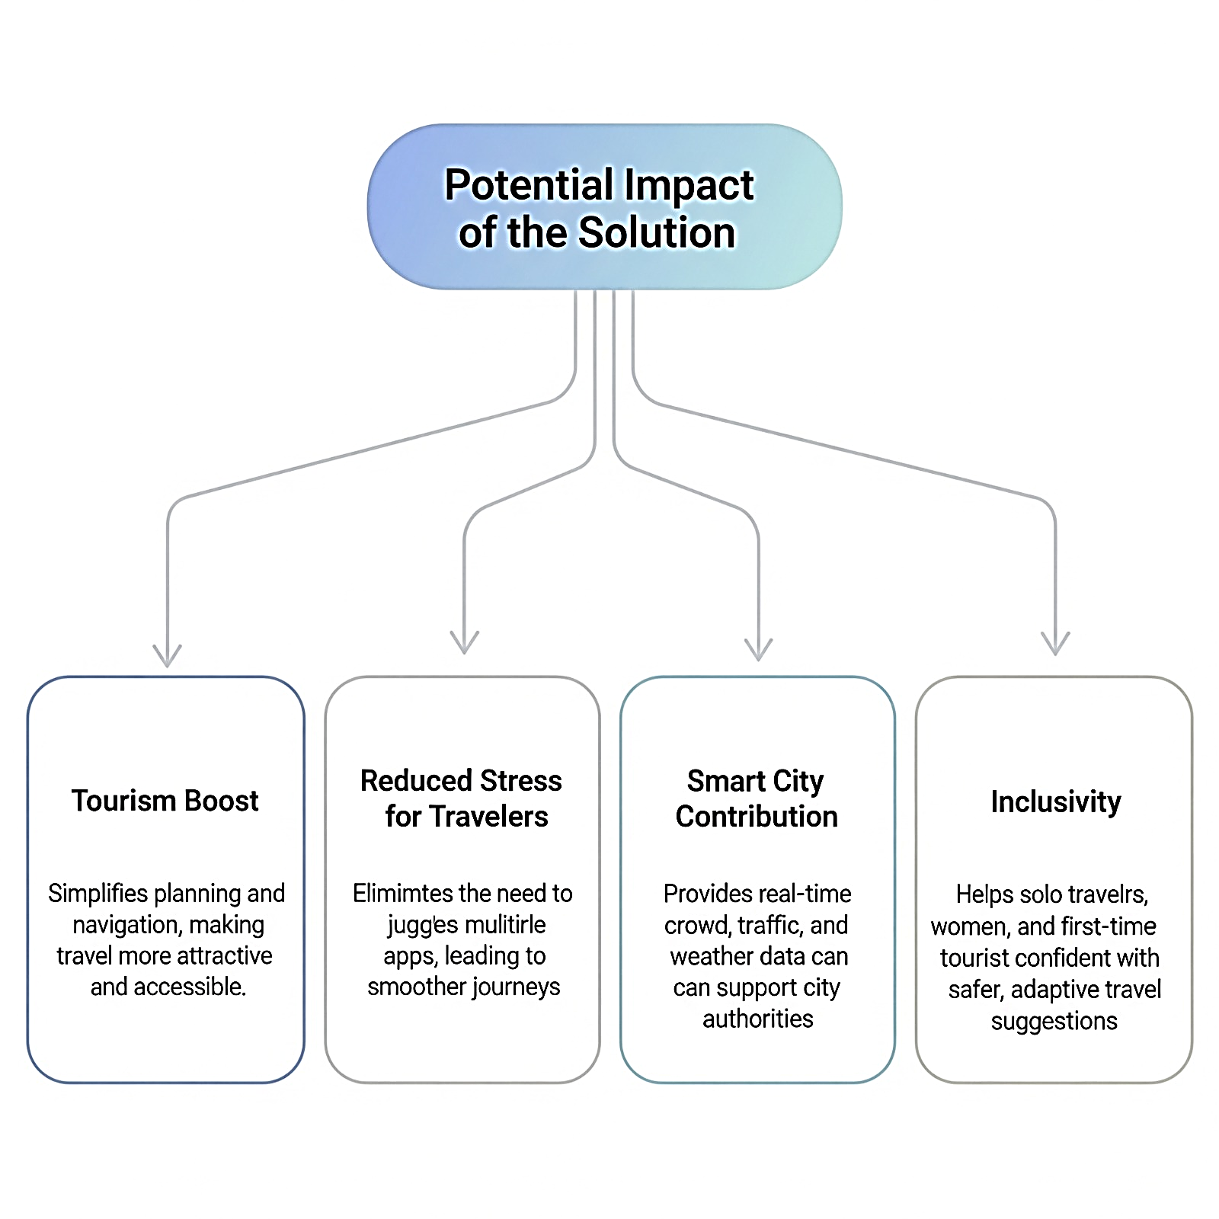
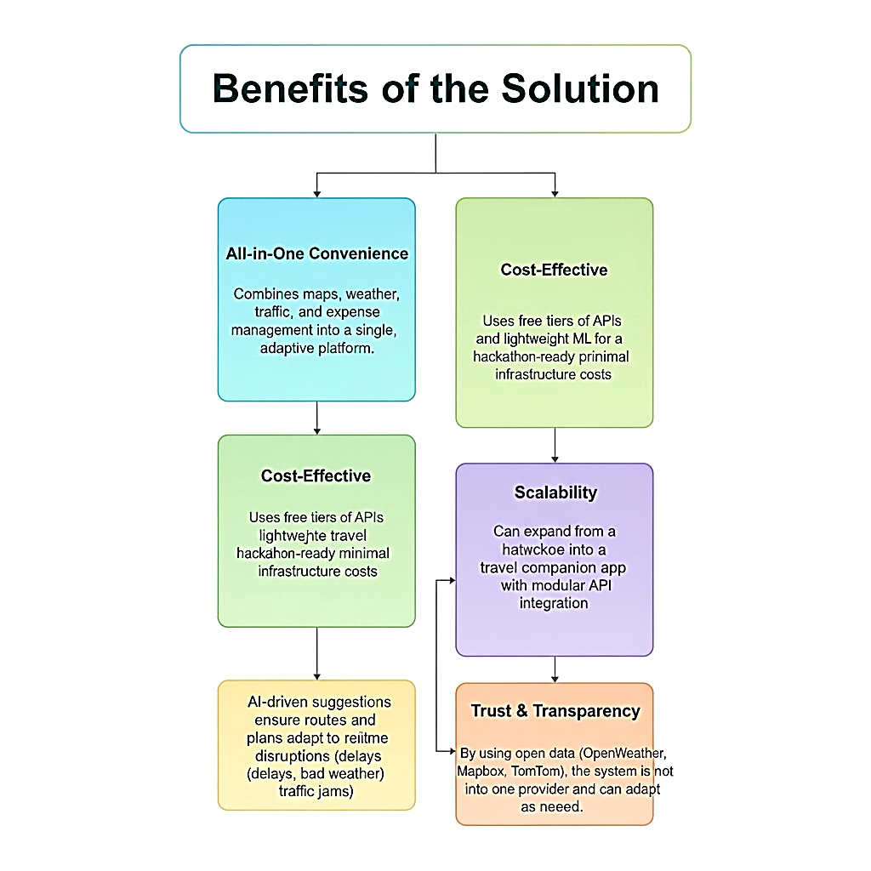
IMPACTS & BENEFITS

